Slide 1
MQTT Bandwidth Estimation
Virtualization environment and Docker

Slide 2
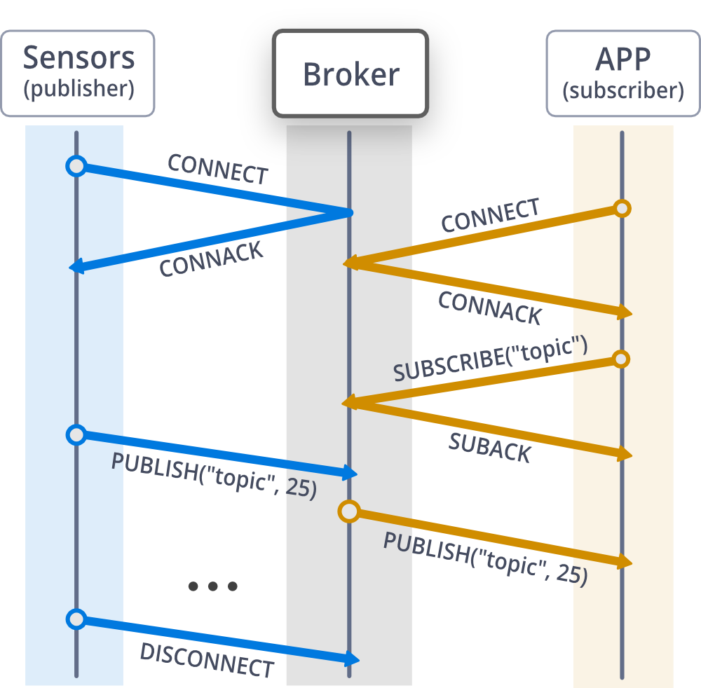
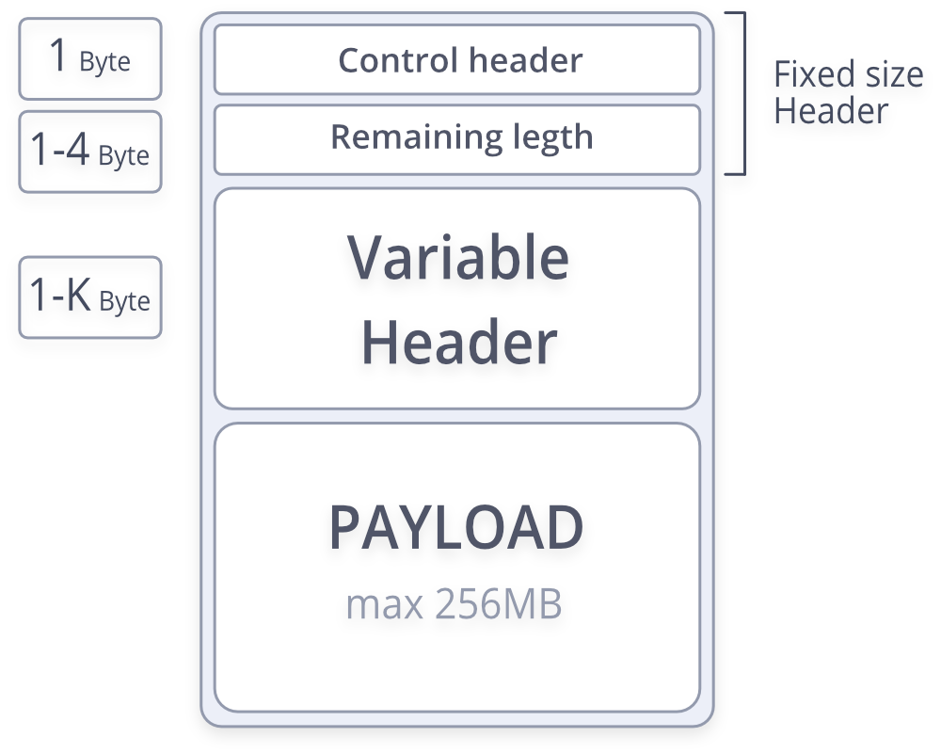
MQTT Protocol
Lightweight protocol for message exchange

Slide 3
Objective
The bench has to estimate the typical bandwidth need of a MQTT protocol implementation. The structure is based on a virtual net composed of sensor and sinks (as publishers), a broker based on Mosquitto and a series of client (as subscribers).

Slide 4
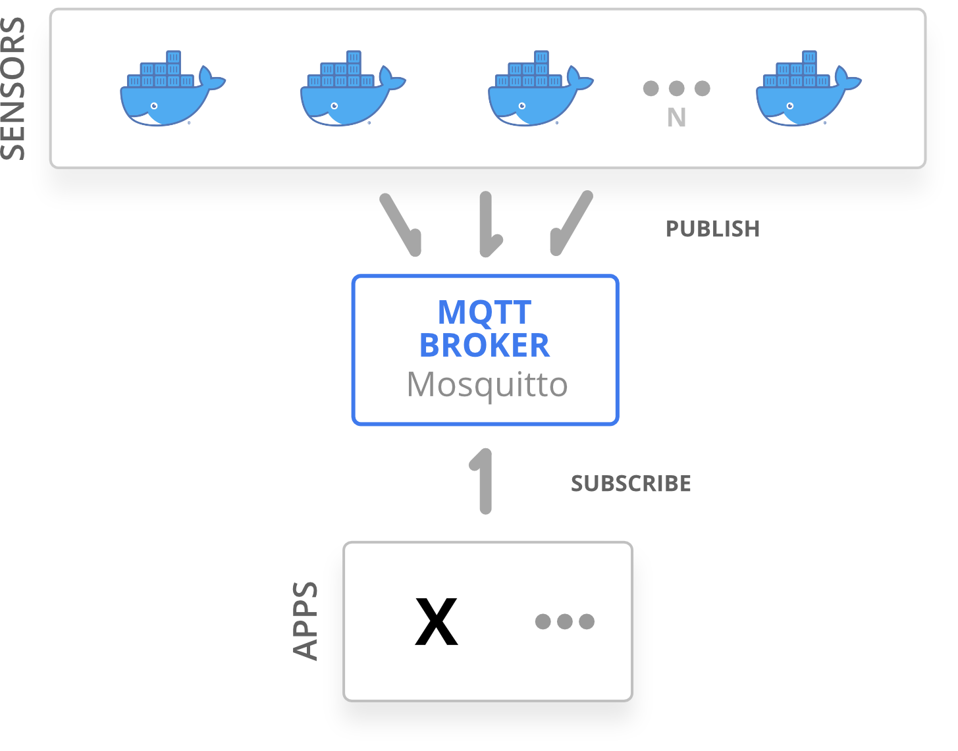
Structure

Slide 5
Sensors (publishers)
Docker based
C language based script with
3 possible propagation behaviour
Low RAM and resource usage
Sink modality
500+ sensors in a test

Slide 6
Broker
Small footprint virtual machine (Alpine based)
Official Eclipse MQTT Mosquitto implementation
Wireshark sniffer + iftop

Slide 7
Testing
Overhead caused by protocol
Overhead caused by QoS levels
Bandwidth with the 3 propagation model
Bandwidth with different number of clients
Different payload size
Use of sinks to convoil traffic
What and how

Slide 8
Results
crescita massima

Slide 9
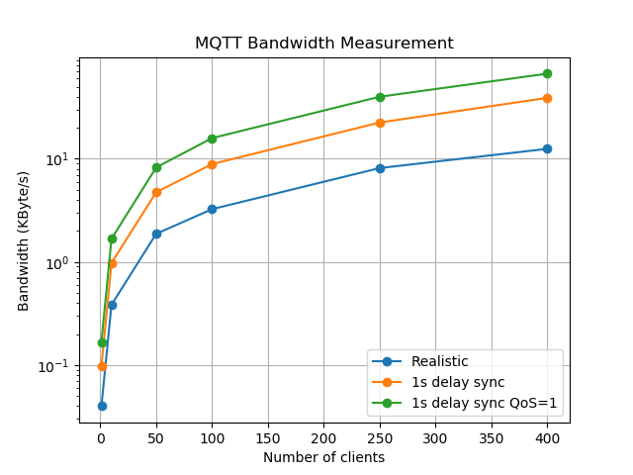
Different number of client with all the propagations pattern (log scale)

Slide 10
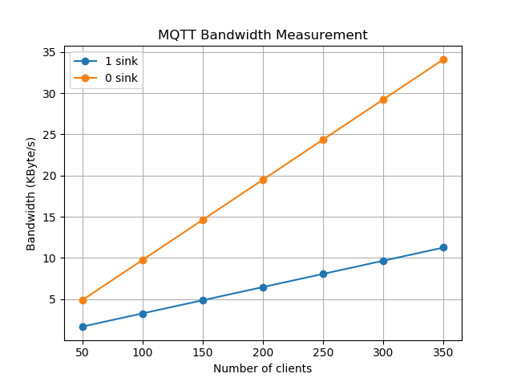
Different number of client with optional sinks

Slide 11
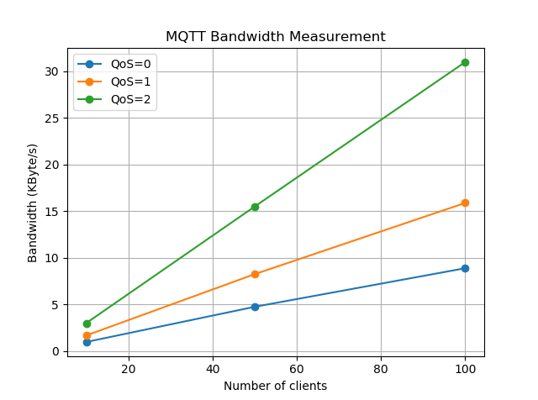
QoS Level Overhead

Slide 12
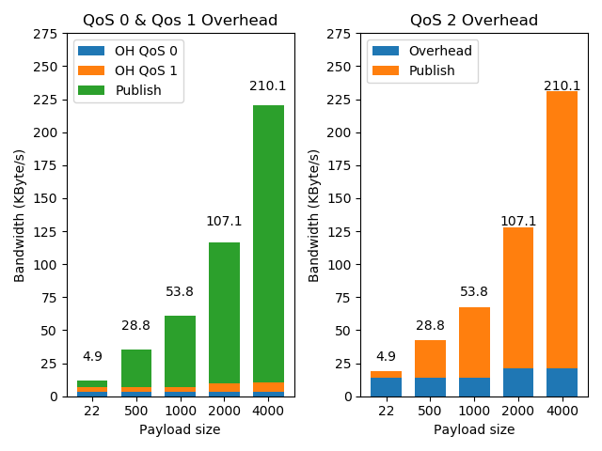
Different payload size and the consequent overhead caused with different QoS level

Slide 13
END

